Slide 1
PROPERTY MARKET ANALYSIS
What Drives Property Price?
Data Cleaning, Exploratory Analysis, Feature Engineering & Hypothesis Testing
300 Listings | 8 Attributes | 4-Stage Analysis Pipeline

Slide 2
Agenda
Objective & Dataset
Methodology
1
2
Data Cleaning & Quality
Univariate Analysis
3
4
Bivariate Analysis
Feature Engineering
5
6
Hypothesis Testing
Findings & Recommendations
7
8
2

Slide 3
Objective & Dataset
Identify which property attributes are meaningfully associated with sale Price, quantify the strength of those relationships, and statistically validate them rather than relying on visual inspection alone.
300
8
Property Records
Attributes Tracked
0
3
Secondary goal: produce a clean, documented, reproducible dataset ready for predictive modeling.
Missing Values
Notebooks in Pipeline
3

Slide 4
Methodology
A three-stage notebook pipeline, each stage answering a distinct question:
1
2
3
➜
➜
Clean
Explore
Test
Is the data trustworthy?
What patterns exist?
Are those patterns real?
1_data_cleaning.ipynb
2_eda.ipynb
3_analysis.ipynb
4

Slide 5
Dataset Column Reference
Column | Type | Description
Property_ID | Text | Unique identifier per listing
Area | Integer | Property size in square feet
Bedrooms | Integer | Number of bedrooms (1–5)
Bathrooms | Integer | Number of bathrooms (1–3)
Age | Integer | Property age in years (0–49)
Location | Category | City Center / Suburb / Rural
Property_Type | Category | House / Villa / Apartment
Price | Integer | Sale price (INR)
5

Slide 6
Data Quality — All Checks Passed
No missing values
No duplicate rows
No duplicate IDs
✓
✓
✓
Correct data types
No invalid ranges
Consistent categories
✓
✓
✓
Zero statistical outliers
7 / 7
✓
Checks Passed
6

Slide 7
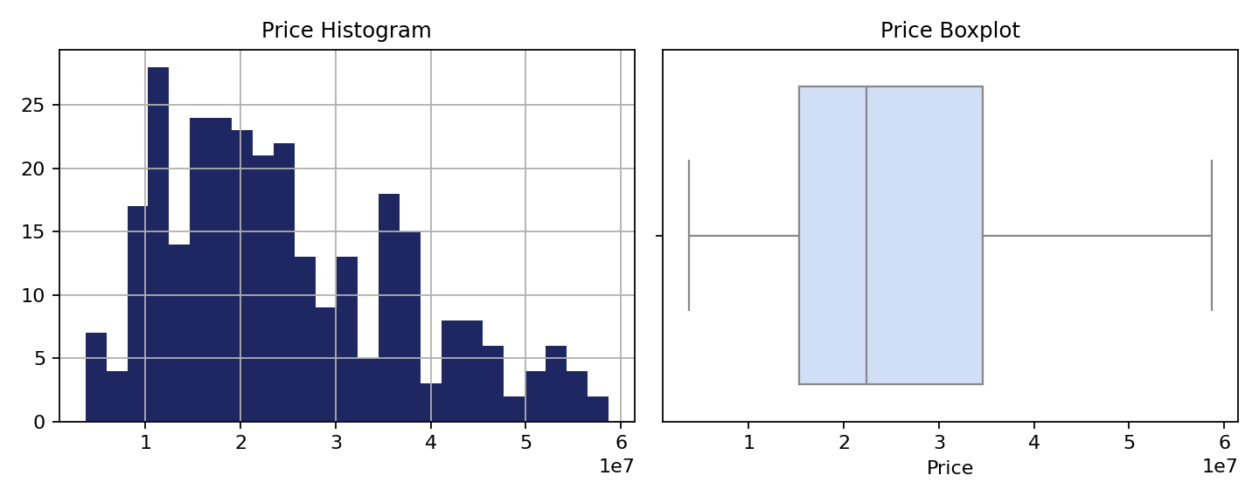
Univariate Analysis — Price
₹2.49 Cr
₹2.24 Cr
0.66
0
Mean
Median
Skewness
Outliers (IQR)
7

Slide 8
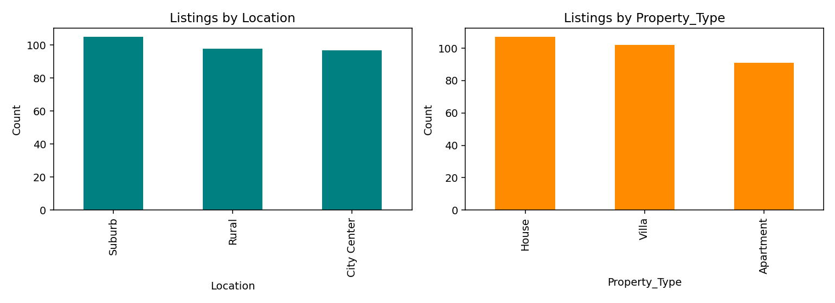
Univariate Analysis — Remaining Columns
Column | Skew | Shape
Area | 0.01 | Symmetric
Bedrooms | -0.12 | Symmetric
Bathrooms | -0.05 | Symmetric
Age | -0.03 | Symmetric
Location & Property_Type listings are evenly distributed — no category dominates the dataset.
Bedrooms and Bathrooms are discrete counts (not continuous), which shows as separated spikes rather than a smooth curve — expected, not a data issue.
8

Slide 9
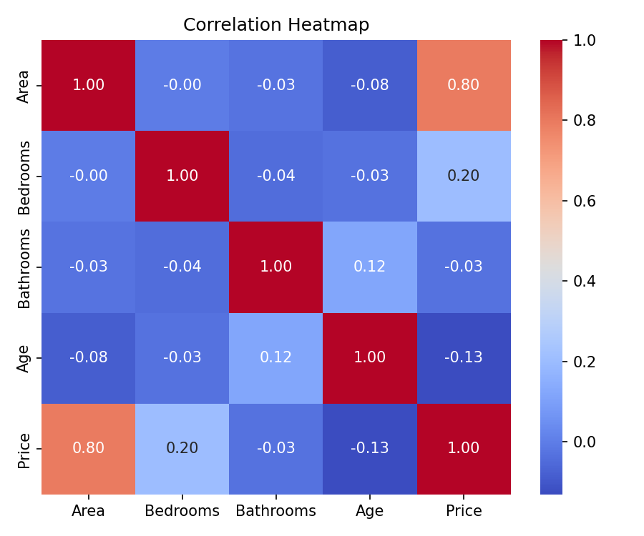
Bivariate Analysis — Correlation
r = 0.80
Area ↔ Price — strong positive correlation
Area correlates strongly with Price — the clearest relationship in the dataset.
Bedrooms shows only a weak positive correlation (r = 0.20).
Bathrooms & Age show negligible correlation with Price (r = -0.03, -0.13).
9

Slide 10
Bivariate Analysis — Price by Location
~2x
City Center vs Rural price gap
Location shows a clear, ordered effect on Price: City Center properties sell for nearly double the price of Rural properties on average.
10

Slide 11
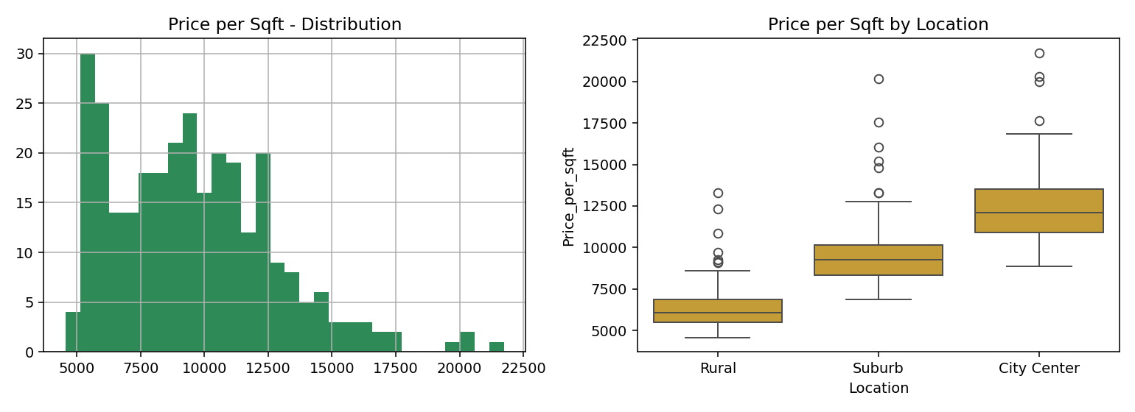
Feature Engineering — Price per Sqft
Price_per_sqft = Price ÷ Area
Normalizes price by size, enabling fair comparison across listings of different scale.
₹12.5K
City Center /sqft
₹6.4K
Rural /sqft
Confirms: City Center commands a genuinely higher rate per sqft — not just a higher price from larger properties.
11

Slide 12
Hypothesis Testing (α = 0.05)
Relationship | Test | p-value | Significant?
Location → Price | ANOVA | < 0.001 | ✓ Significant
Area ↔ Price | Pearson | < 0.001 | ✓ Significant
Property_Type → Price | ANOVA | 0.062 | ✗ Not significant
Location ↔ Property_Type | Chi-square | 0.978 | ✗ Not significant
Key takeaway: Property_Type's mild visual effect on Price (seen in boxplots) does NOT hold up under formal testing (p = 0.062) — a reminder that plots alone can mislead.
12

Slide 13
Key Findings
Area is the strongest driver of Price
r = 0.80, p < 0.001
1
Location has a significant, ordered effect
City Center > Suburb > Rural, p < 0.001
2
Property_Type does NOT significantly affect Price
p = 0.062
3
Bedrooms, Bathrooms, Age show weak/no effect
Individually negligible
4
Location & Property_Type are independent
p = 0.978
5
13

Slide 14
Limitations & Recommendations
Limitations
Recommendations
Moderate sample size (n = 300)
Dataset unusually clean — limited real-world messiness
Correlation shown, not causation
Only linear relationships tested
Property_Type result is borderline (p = 0.062)
Build a regression model using Area + Location
Deprioritize Property_Type in pricing models
Collect a larger sample to retest borderline results
Explore interaction effects (Area × Location)
14

Slide 15
Conclusion
Area and Location are the primary, statistically validated drivers of property Price. Property_Type, Bedrooms, Bathrooms, and Age contribute little independent signal. The cleaned dataset and validated findings provide a solid foundation for a predictive pricing model.
0.80
<0.001
2x
7/7
Area–Price r
Location p-value
City vs Rural gap
Quality checks passed
Thank you

